Slide 1
CCGAN / cycleVAE 비교 실험
4화자: F1,F2,M1,M2
10화자: F1~5, M1~5
100화자: F1~50, M1~50
MCD | CCGAN | cycleVAE
F to F | 6.52 ± 0.31 | 6.61 ± 0.32
F to M | 6.16 ± 0.25 | 6.32 ± 0.23
M to F | 6.43 ± 0.29 | 6.95 ± 0.32
M to M | 5.82 ± 0.22 | 6.04 ± 0.2
Total | 6.25 ± 0.15 | 6.53 ± 0.16
Training Time(hour) | CCGAN | cycleVAE
100 | 6.86 ± 0.13 | 6.65 ± 0.15
200 | 6.67 ± 0.13 | 6.64 ± 0.15
300
400
500
Training Time(hour) | CCGAN | cycleVAE
100 |  | 6.67 ± 0.16
200 |  | 6.66 ± 0.16
300
400
500

Slide 2
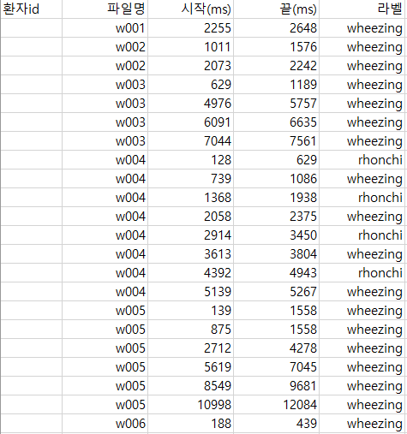
청진음
엑셀파일을 참조하여 1000ms, 500ms segment를 추출
25ms마다 1 frame을 추출, 10ms씩 shift하면서 log mel-spectrogram을 계산
=> 10ms=1frame
strict하게 구간 설정
ex) w005파일 [8549, 9681] -> [8550, 9680] -> [855, 968] frame
=> [855, 904] frame, [905, 954] frame 저장
1000ms segment
총 466 segment(normal: 443, rale: 15, rhonchi: 3, wheezing: 5)
500ms segment
총 971 segment(normal: 900, rale: 41, rhonchi: 14, wheezing: 23)
- train set
normal: 7
rale: 2
rhonchi: 2
wheezing: 2
- test set
normal: 2
rale: 1
rhonchi: 1
wheezing: 1
- train set
normal: 34
rale: 11
rhonchi: 11
wheezing: 11
- test set
normal: 8
rale: 3
rhonchi: 3
wheezing: 3

Slide 3
CCGAN / cycleVAE 비교 실험
1000ms segment
500ms segment
epoch | kernel:40x5 padding:2 stride:1 | kernel:40x10 padding:5 stride:1 | kernel:40x15 padding:7 stride:1 | kernel:40x20 padding:10 stride:1
100 | 40.0% | 40.0% | 40.0% | 40.0%
300 | 40.0% | 60.0% | 40.0% | 40.0%
500 | 40.0% | 40.0% | 40.0% | 40.0%
1000 | 40.0% | 40.0% | 40.0% | 40.0%
epoch | kernel:40x5 padding:2 stride:1 | kernel:40x10 padding:5 stride:1 | kernel:40x15 padding:7 stride:1 | kernel:40x20 padding:10 stride:1
100 | 70.59% | 88.24% | 64.71% | 88.24%
300 | 70.59% | 52.94% | 58.82% | 76.47%
500 | 70.59% | 47.59% | 76.47% | 35.29
1000 | 50.82% | 52.94% | 41.18% | 82.35%

